Slide 1
Smart Battery Charger
For you and for the world
Team members:
Anna Geraci s296018
Carlo Simone
Fabio Gianino
Michele Petrocelli

Slide 2
General information about Smart Battery Charger application
Objective:
Main characteristics:
Stakeholders:
IMMAGINE

Slide 3
Communication paradigms used
REST:
How it works
MQTT How it works

Slide 4
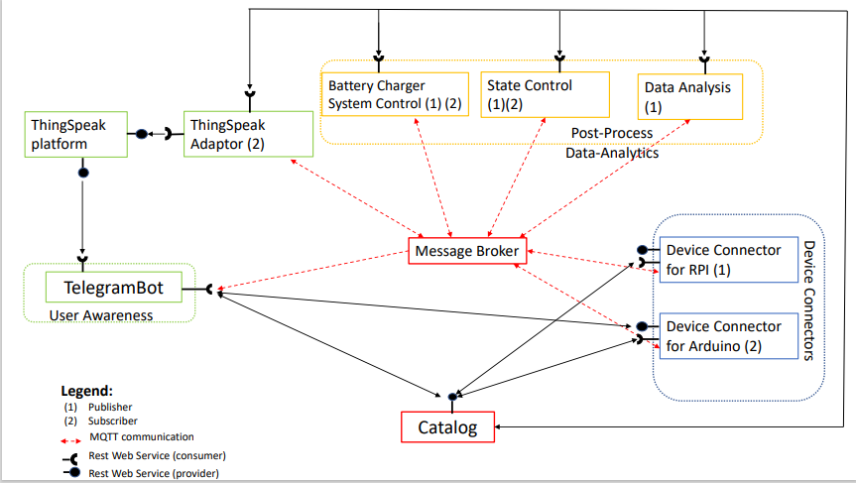
Use Case Diagram - proposal

Slide 5
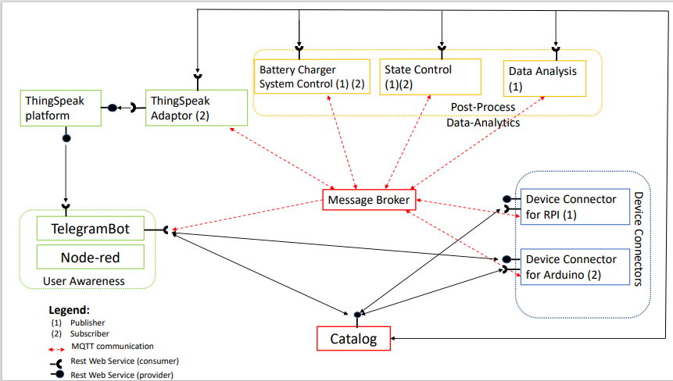
Use Case Diagram - update

Slide 6
Catalog

Slide 7
Device Connectors

Slide 8
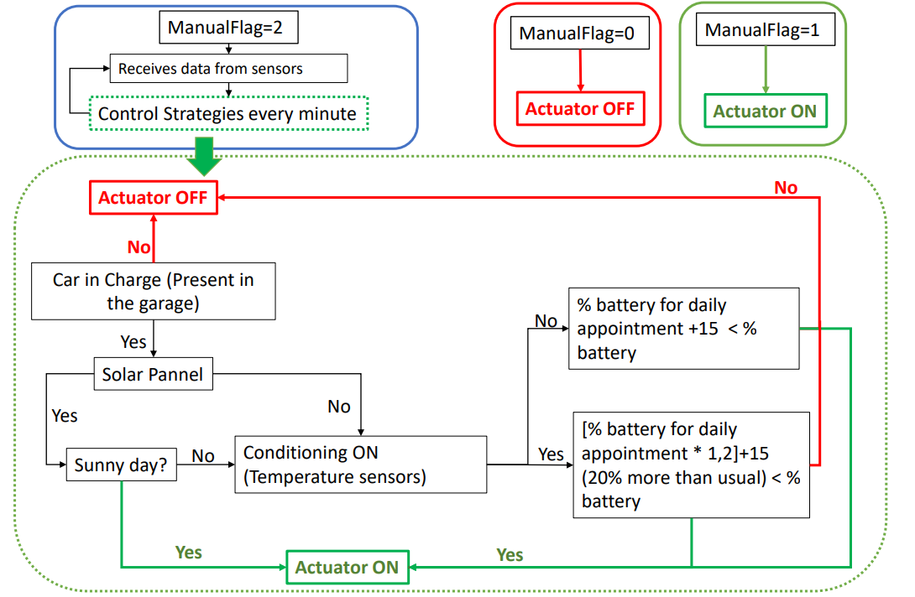
Battery Charger System Control
Communication with:
Sensors: Retrieves data from sensors and process them.
Actuator: Sends command to the actuator (On/Off).
User: Retrieves data about what the user want through User Awareness interface (Node-red and Telegram - ManualFlag).
Catalog: Retrieves data of the user and general data of the application; and publish the value of the actuator computed.
Control Strategy Agenda: Retrieves the value of the percentage of battery necessary in this day according to the Agenda of the user.
Main role:
Retrieve data and choose if the car must be in charge or not according to the logic reported on the right.

Slide 9
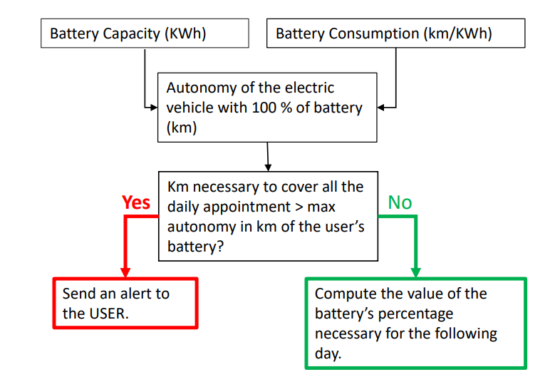
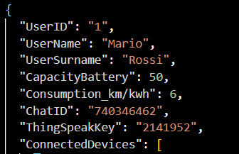
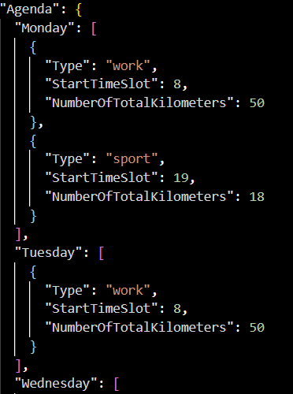
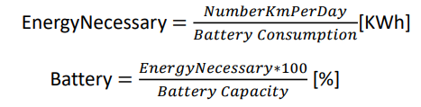
Agenda Control Strategy Compute the percentage of battery necessary to the specific user each day, according to the Agenda information.
Catalog Format in User section
Communication with:
Catalog: to retrieve information about user’s battery characteristics and user’s Agenda.
StateControl: to send AlertSMS, in case it may be necessary.
Actuator Control Strategy: to send information about the percentage of battery needed by the user in this specific day.
Main role:
Compute the percentage of battery necessary for the users during this day, according to the battery characteristics and the personal commitments.

Slide 10
State Control
Communication with:
Sensors: to retrieve information about the status of the battery and general information.
TelegramBot: to send AlertSMS, in case it may be necessary.
Agenda Control Strategy: to retrieve information in case the number of kilometers is too high for a single recharge cycle.
Main role:
Compute the percentage of battery necessary for the users during this day, according to the battery characteristics and the personal commitments.
Vehicle present in charge station
Temperature of the battery.
Percentage of battery too low
Km necessary more than autonomy

Slide 11
Data Analisys & ThingSpeak

Slide 12
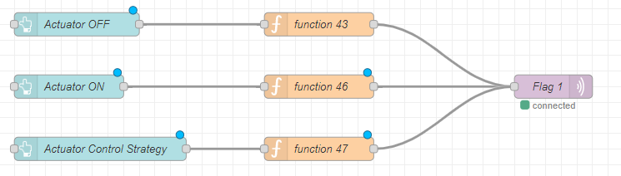
Node-red
Communication via MQTT with:
Sensors: to retrieve the information that they detect.
Actuator Control Strategy: to send information about value of the flag about the manual actuation.
Main Role:
Visualize data come from sensors and allow the user to set the Charger On or Off manually, through 3 buttons that sends MQTT messages to the topic related to the manualFlag.
IMMAGINE DASHBOARD FUNZIONANTE

Slide 13
Telegram Bot
Command:
/start: Show to the user all the command available on TelegramBot.
/IsPresence: Communicate to the user if the vehicle is in charge station or not.
/AlertSMS: Communicate to the user if there are issue about the charging of his vehicle.

Slide 14
Telegram Bot
/Agenda*day*: Show to the user the Agenda saved in the catalog according with the *day* specified.
/Agenda*day*Update: Allow the user to add to the Agenda a new commitments in this specific *day*
/ViewGraphs: Show to the user all the graph about the sensors and use of the application.

Slide 15
Telegram Bot
/switch: Allow the user to choose the charge status of the car.
/exit: Allow the user to exit from any request

